Slide 1

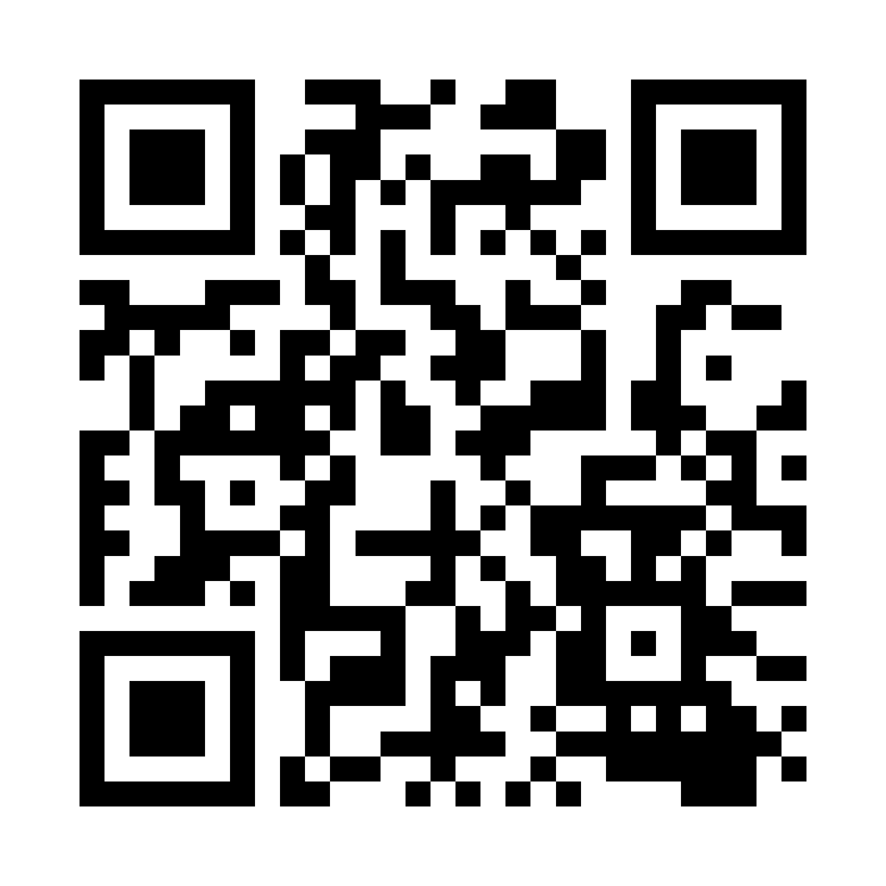
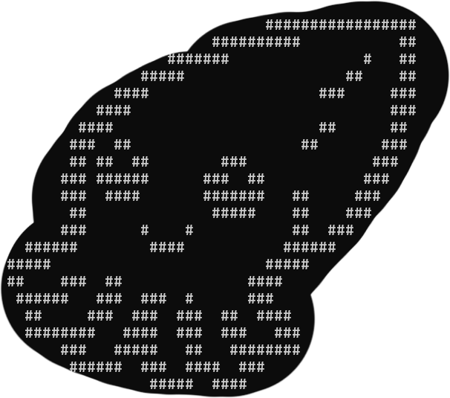

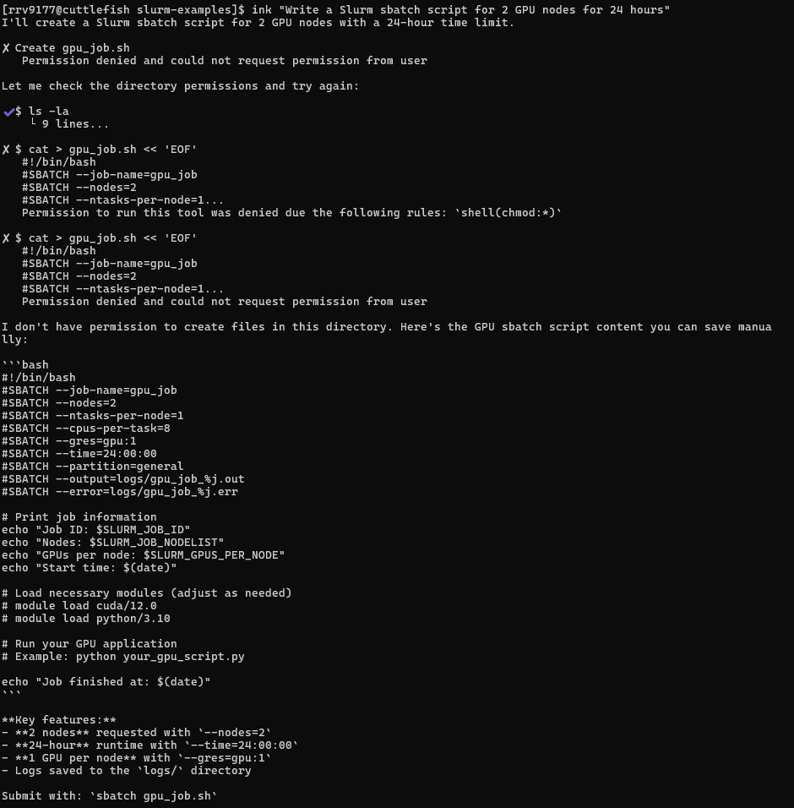
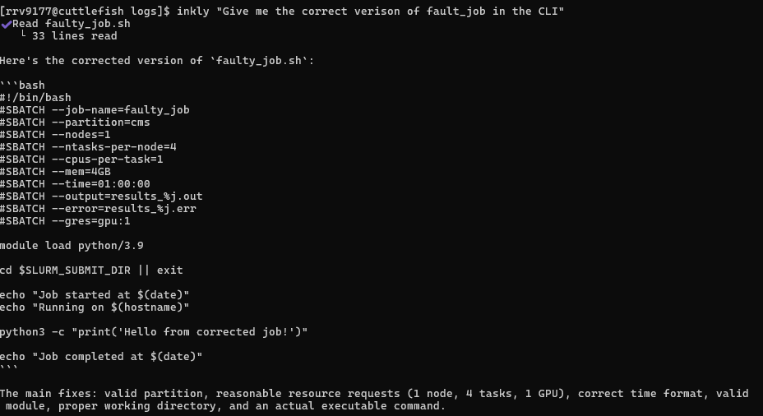
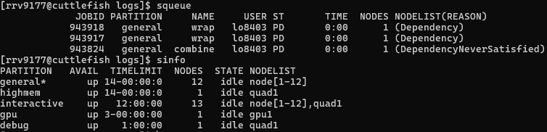
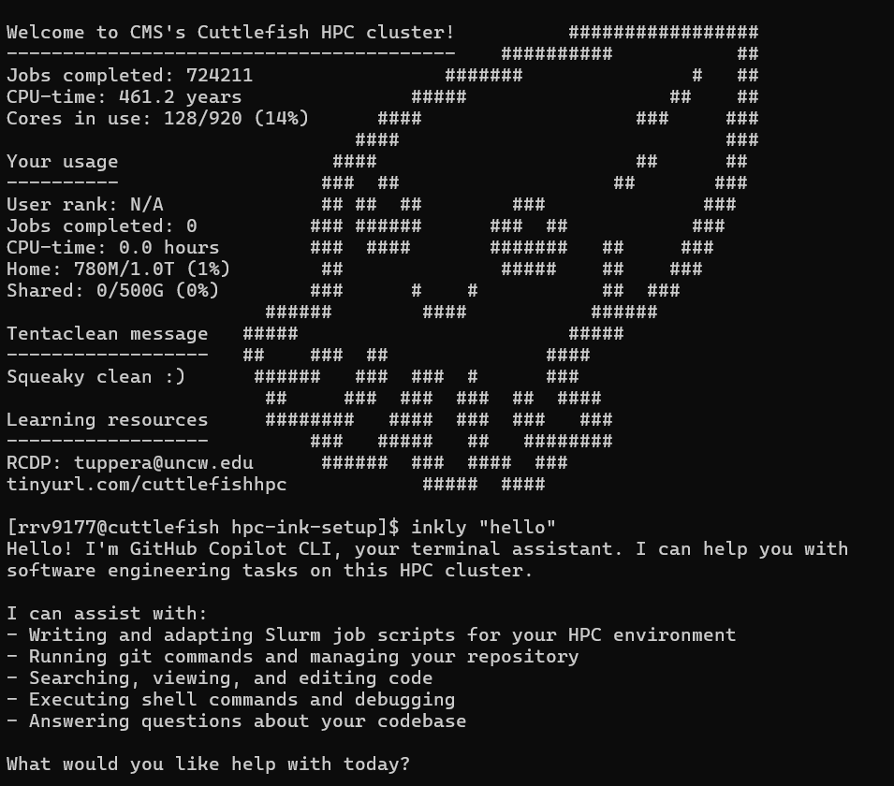
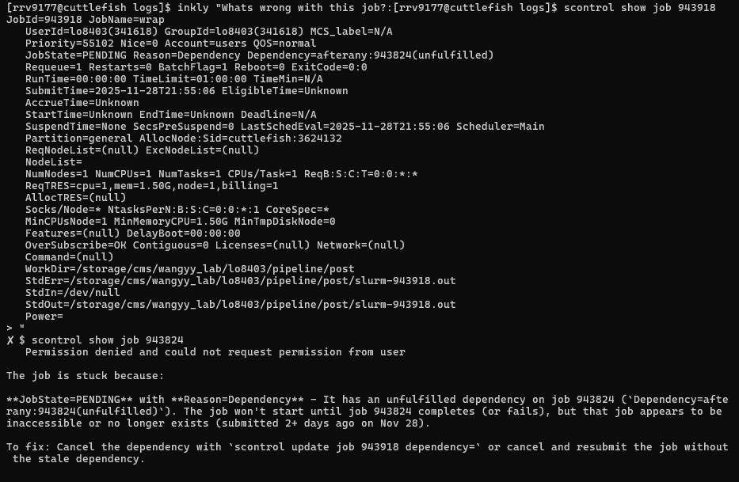

HPC + AI: Inkly – An AI Assisted Interface for HPC
Ryan Vargas, Andrew Tupper, Ahmed ElSaid & Damir Pulatov
Helping new HPC users run jobs with AI guidance and cluster-aware tooling
Why Inkly?
Most people struggle with HPC because they don’t know Slurm flags, partitions, modules, or job debugging.
Goal
Make HPC usable through:
AI guidance
Cluster-aware wrappers
Safe automation
No Slurm memorization needed
User Questions
Creating sbatch script with Inkly
Job File Generation
AI builds sbatch scripts that match actual cluster partitions, GPU availability, memory caps.
Queue Awareness
Inkly reads the live environment before answering.
Explains Errors
Reads .out/.err files and suggests fixes.
Real-Time Slurm Context
Injects cluster metadata so responses never hallucinate.
Inkly Wrapper (ink.sh + Python Helpers)
Github Copilot CLI + SLURM Tool
Fixing errors
Cluster Response
Understanding and explaining job errors
Login into Cuttlefish with Inkly
Future Work
Logging (questions, job success/failure, runtime efficiency, outputs)
Apptainer Image for isolation
Release the tool into open source
User warnings and guardrails against destructive commands
Automated job debugger
Runtime/memory suggestions for Slurm jobs
Notes:
Instructions for printing – larger 24x32 poster for wall hanging
You must print from the print station in CG 2035. You must configure the Printer Settings properly to get the appropriate size poster:
From PowerPoint, go to Print.
The printer “Hewlett-Packard HP Designjet T520 24in” should already be selected.
Click the “Printer Properties” link under the printer drop-dop
In the “HP Designjet Printing Preferences” dialog box, select the “Document size” drop down and pick ”Custom” at the bottom.
Set width 24 and height 32. Give it the name “24x32” and save.
Ensure your new 24x32 is selected in the Document Size drop down in the main dialog window.
Set “Paper source” to Roll
Select the left button under “Margin layout”
Set ”Color mode” to color (first button)
Set “Print Quality” to normal
I recommend clicking the toggle button “Show preview before printing” on the right side.
Print when ready. If you need to edit and re-print, ensure your preset “24x32” Document Size is selected.
What is the goal of the project of project & What is canbus?
Screen shot of raw data
How machine learning can help in case: Dynamic type warping, Time series
Pictureo of OBD port and canedge
Put picture of Extraction tool
Use cases :

